Slide 1
Relational Data Model
Dr. Anand Bihari
SJT Annex- 203N
anand.bihari@vit.ac.in

Slide 2
Relational Data Model
It represents the database as a collection of relations.
Relational Model was proposed by E.F. Codd to model data in the form of relations or tables.
Relational Model represents how data is stored in Relational Databases.
The standard database model for most transactional database today.

Slide 3
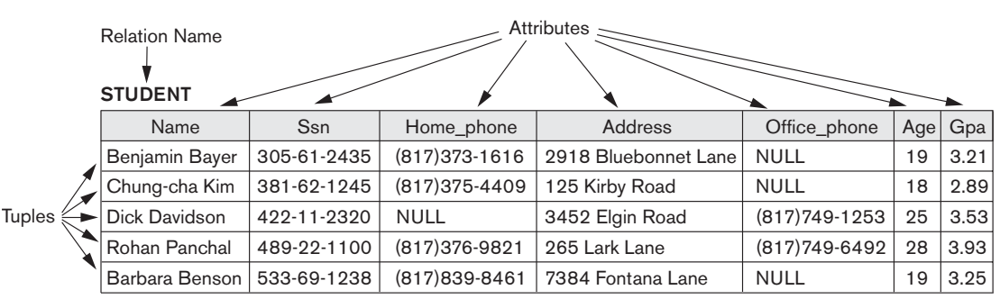

Slide 4
Relational Model Terminology
Relation : Table is called relation.
Tuple: Row is called tuple.
Attribute: A column header is called attribute.
Domain: Set of atomic value (Scope of the attribute). Ex. A valid roll number, set of all integer, etc.
Degree: The total number of attributes which in the relation is called the degree of the relation.
Cardinality: Total number of rows present in the Table.
Cartesian product specifies all possible combinations of values from the underlying domains.

Slide 5
R– Relation 1
S- Relation 2
T= R x S
Cardinality of R=4
Cardinality of S=5
Cardinality of T= 4 x 5 =20.

Slide 6
Relation Schema and Instance
A₁, A₂, …, A_{n} are attributes
R = (A₁, A₂, …, A_{n} ) is a relation schema
Example: instructor = (ID, name, dept_name, salary)
Formally, given sets D₁, D₂, …. D_{n} a relation r is a subset of D₁ x D₂ x … x D_{n}
Thus, a relation is a set of n-tuples (a₁, a₂, …, a_{n}) where each a_{i} ∈ D_{i}

Slide 7
Characteristics of Relations
Ordering of tuples: Mathematically, tuples in relations don’t have ordering (although in reality they do have order when stored in files or disk).
Ordering of attributes: Attributes within a tuple have to maintain order if they are stored as tuples.
A relation schema R = {A₁, A₂, ..., A_{n}} is a set of attributes, and a relation state r(R) is a finite set of mappings r = {t₁, t₂, ..., t_{m}}, where each tuple t_{i} is a mapping from R to D, and D is the union of the attribute domains; that is, D = dom(A₁) ∪ dom(A₂) ∪ ... ∪ dom(A_{n}).

Slide 8
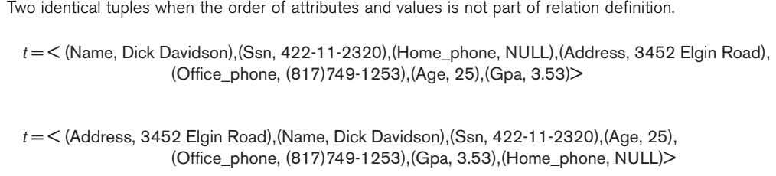
Characteristics of Relations

Slide 9
Characteristics of Relations
Values of Tuples: Each value that makes up a tuple is atomic and cannot be further subdivided. This is also called first normal form

Slide 10
Relational Constraints
Domain constraints
Key constraints
Referential integrity constraints
Other types of constraints
Trigger, Assertions, etc..

Slide 11
Domain Constraints
A domain constraints specifies that value of each attribute must be atomic and a member of dom(A).
These are attribute level constraints.
An attribute can only take values which lie inside the domain range. e.g,; If a constrains AGE>0 is applied on STUDENT relation, inserting negative value of AGE will result in failure.

Slide 12
Key Constraints
Primary Key: Attribute takes unique value without null
Unique Key: Attributes takes unique value with null
Candidate Key:
A candidate key is a column, or set of columns, in a table that can uniquely identify any database record without referring to any other data.
Super Key:
The set of attributes which can uniquely identify a tuple is known as Super Key.
Composite Key: A set of Primary key in a relation is called composite key.
Alternate Key:
The candidate key other than primary key is called as alternate key.
Foreign Key:
If an attribute can only take the values which are present as values of some other attribute, it will be foreign key to the attribute to which it refers.

Slide 13
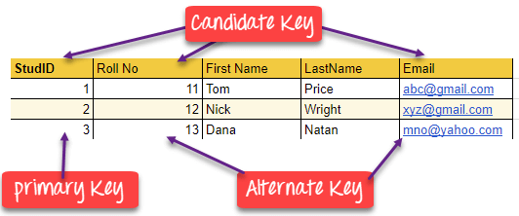

Slide 14
Anomalies
An anomaly is an irregularity, or something which deviates from the expected or normal state.
Insertion Anomaly:
If a tuple is inserted in referencing relation and referencing attribute value is not present in referenced attribute, it will not allow inserting in referencing relation.
Deletion/Updation Anomaly:
If a tuple is deleted or updated from referenced relation and referenced attribute value is used by referencing attribute in referencing relation, it will not allow deleting the tuple from referenced relation.

Slide 15
Codd Rules in DBMS
Edgar F. Codd, the creator of the relational model proposed 13 rules known as Codd Rules that state:
For a database to be considered as a perfect relational database, it must follow the following rules:
Foundation Rule - The database must be able to manage data in relational form.
Information Rule - All data stored in the database must exist as a value of some table cell.
Guaranteed Access Rule - Every unique data element should be accessible by only a combination of the table name, primary key value, and the column name.
Systematic Treatment of NULL values - Database must support NULL values.
Active Online Catalog - The organization of the database must exist in an online catalog that can be queried by authorized users.
View Updating Rule - All views should be theoretically and practically updatable by the system.

Slide 16
Comprehensive Data Sub-Language Rule - Database must support at least one language that supports: data definition, view definition, data manipulation, integrity constraints, authorization, and transaction boundaries.
Relational Level Operation Rule - The database must support high-level insertion, updation, and deletion operations.
Physical Data Independence Rule - Data stored in the database must be independent of the applications that can access it i.e., the data stored in the database must not depend on any other data or an application.
Logical Data Independence Rule - Any change in the logical representation of the data (structure of the tables) must not affect the user's view.
Integrity independence - Changing the integrity constraints at the database level should not reflect any change at the application level.
Distribution independence - The database must work properly even if the data is stored in multiple locations or is being used by multiple end-users.
Non-subversion Rule - Accessing the data by low-level relational language should not be able to bypass the integrity rules and constraints expressed in the high-level relational language.

Slide 17
Advantages of Relational Model
Simplicity: A relational data model is simpler than the hierarchical and network model.
Structural Independence: The relational database is only concerned with data and not with a structure. This can improve the performance of the model.
Easy to use: The relational model is easy as tables consisting of rows and columns is quite natural and simple to understand.
Query capability: It makes possible for a high-level query language like SQL to avoid complex database navigation.
Data independence: The structure of a database can be changed without having to change any application.
Scalable: Regarding a number of records, or rows, and the number of fields, a database should be enlarged to enhance its usability.

Slide 18
Disadvantages of Relational model
Few relational databases have limits on field lengths which can't be exceeded.
Relational databases can sometimes become complex as the amount of data grows, and the relations between pieces of data become more complicated.
Complex relational database systems may lead to isolated databases where the information cannot be shared from one system to another.

